Slide 1
Welcome to Bylaws

Slide 2
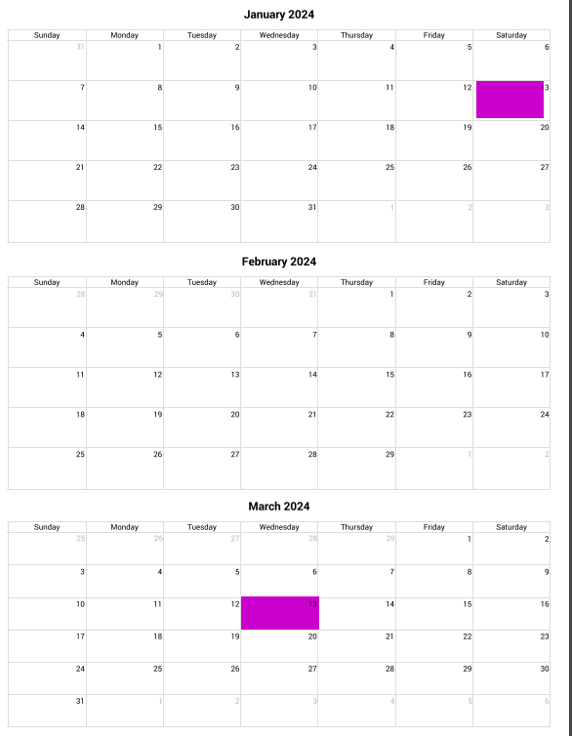
Bylaws Schedule
30 to 90 days prior to the Missouri State convention proposed Missouri bylaws sent to all chapters (January 13th - March 13th)
Spring 2024 Amended bylaws approved by delegates at the Missouri Convention
October 14, 2024 Missouri amended bylaws due to International Bylaws Committee

Slide 3
Missouri Proposed Bylaws
International has gone to a TEMPLATE method of collecting State / Province/ Nation bylaws. This allows S/P/Ns to personalize the Bylaws in the following areas:
Article 1 - Name
Missouri, founded on March 19, 1949 in Mound City, Mo.
Article VII - Officers
Missouri officers are:
President
President-elect
Secretary, treasurer
Historian
Chaplain
President of the Missouri council of presidents
Immediate past president.

Slide 4
Missouri Proposed Bylaws, continued
Additional Officers which may be optional
Vice president for membership
Corresponding secretary
Sergeant-at-arms

Slide 5
Missouri Proposed Bylaws, continued
Article VIII - Committees The following shall be designated as state, provincial or national committees: Alpha Delta Kappa Month, altruistic, budget, bylaws, candidate qualifications, fraternity education, membership
Missouri additional committees are:
Auditing
Courtesy
Excellence in education
Resolutions
Scholarship
State convention
Sustaining members
Technology
World Understanding

Slide 6
Missouri Proposed Bylaws, continued
Article XI - Regions, regional Leadership and Regional Conferences
South Central
Article XII - Stare, Provincial or National Convention
Each elected state officer
Each past state president
Each state committee chairman
All members registered and attending the convention
All members registered and attending the convention

Slide 7
Proposed Missouri Bylaws continued
Article XIII - State, Provincial or National Council of Chapter Presidents
The Missouri council of chapter presidents shall meet in conjunction with the state convention in the even-numbered years.
Article XIV -Districts
Missouri does not currently have districts.

Slide 8
Missouri Proposed Bylaws, continued
Article XV - City Area Councils of Chapter Presidents
Missouri does not currently have city/area councils of chapter presidents.
Article XVIII - Publications
The official newsletter of Missouri Alpha Delta Kappa shall be the MISSOURI SHOW-ME NEWS.

Slide 9
Questions???

